Slide 1

Vel Tech Rangarajan Dr. Sagunthala R&D Institute of Science and Technology
School of Computing
Department of Computer Science and Engineering
10211CS224 / FULL STACK APPLICATION DEVELOPMENT (JAVA)
PROJECT REVIEW : MILESTONE PROJECT – 2
Date: 20-04-2026
Job Portal Management System using Spring Boot
SDG: SDG 8 – Decent Work and Economic Growth
Presented By:
A. PAVAN KUMAR– VTU28374 – 23UECS2029.
Courses Handling Faculty:
Dr. NATTESHAN. N.V.S

Slide 2
INTRODUCTION
1
Finding suitable jobs manually is time-consuming and inefficient.
Many students struggle to discover relevant job opportunities.
Employers face difficulty in receiving and organizing applications.
The project provides an online Job Portal connecting job seekers and employers.
Students can create profiles and upload resumes.
Students can search for jobs and apply online easily.
Employers can post jobs and manage applicants.
Employers can shortlist suitable candidates quickly.
The system improves hiring efficiency and transparency.
It increases accessibility for users anytime, anywhere.
Useful for colleges, companies, and recruitment agencies.
2
3
4
5
6
7
8

Slide 3
PROBLEM STATEMENT
Existing recruitment systems often rely on manual processes.
Job seekers must search multiple platforms for opportunities.
Students face delays in finding suitable jobs.
Employers receive large numbers of applications that are difficult to organize.
Manual resume screening consumes significant time and effort.
Lack of centralized data causes poor candidate tracking.
Communication between employers and applicants is often delayed.
Existing systems may lack transparency in application status updates.
Managing recruitment manually reduces efficiency and productivity.
There is a need for a secure, centralized, and automated Job Portal system.
1
2
3
4
5
6
7
8
9

Slide 4
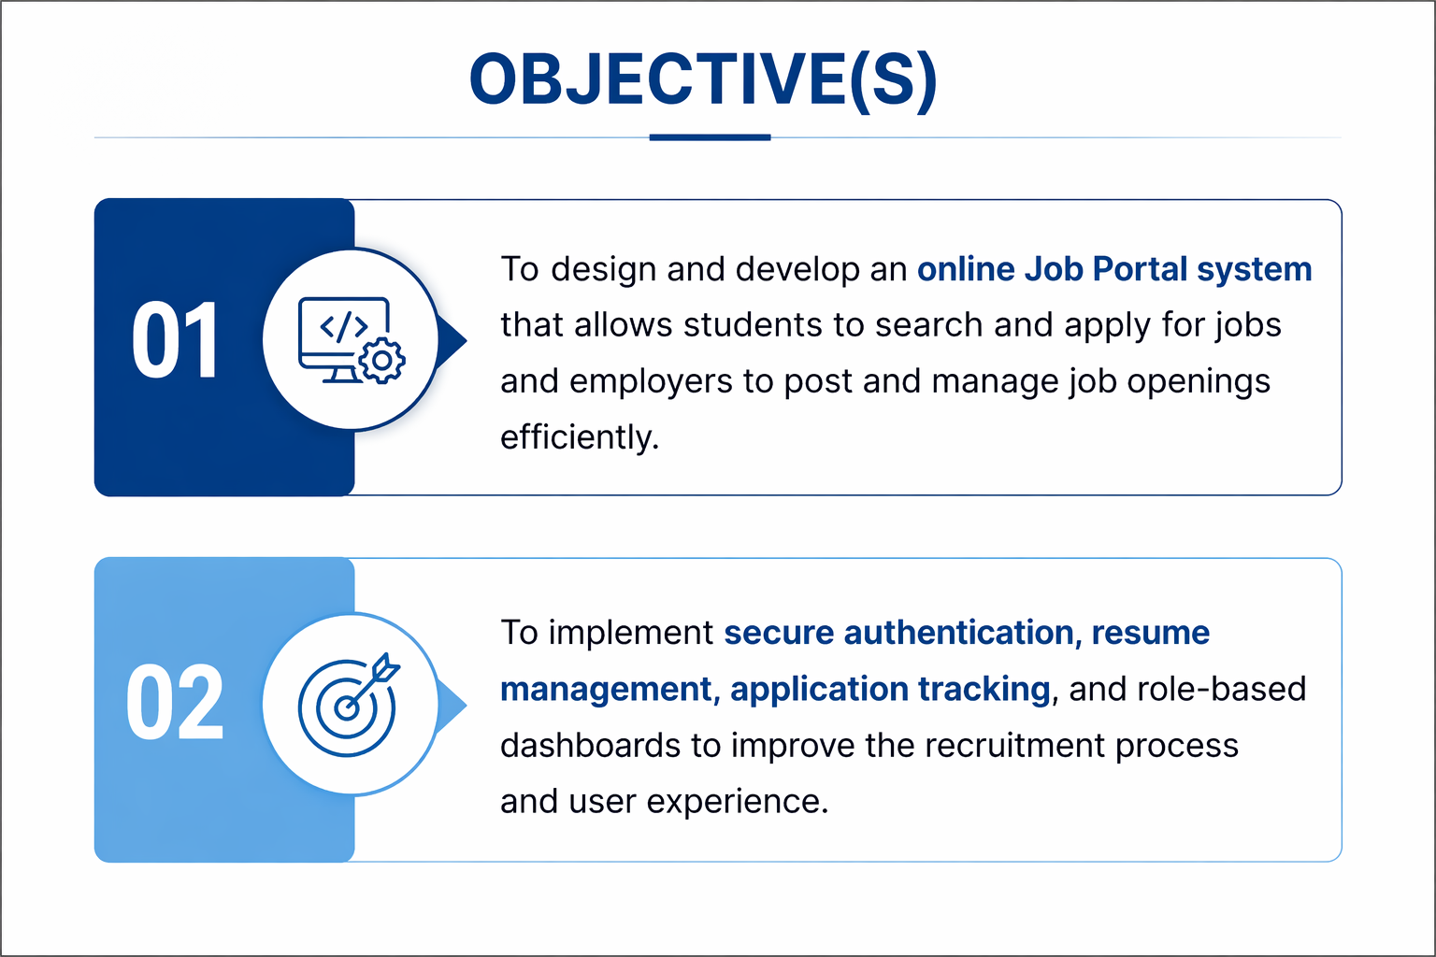
OBJECTIVE(S)
1
2
3
4
5
6
7
8
9

Slide 5
PROPOSED SYSTEM
Provides a centralized online platform for students, employers, and admin users.
Students can register, log in, and manage their profiles securely.
Resume upload feature allows students to submit documents easily.
Students can search jobs by category, location, skills, or experience.
One-click online job application system for faster recruitment.
Employers can post new job openings with complete details.
Employers can edit or delete job postings anytime.
Employers can view applicants and shortlist/reject candidates.
Admin can manage users, jobs, and overall system activities.
Secure authentication using Spring Security and encrypted passwords.
Real-time application status tracking for students.
Improves recruitment efficiency, transparency, and user experience.
1
2
3
4
5
6
7
8
9

Slide 6
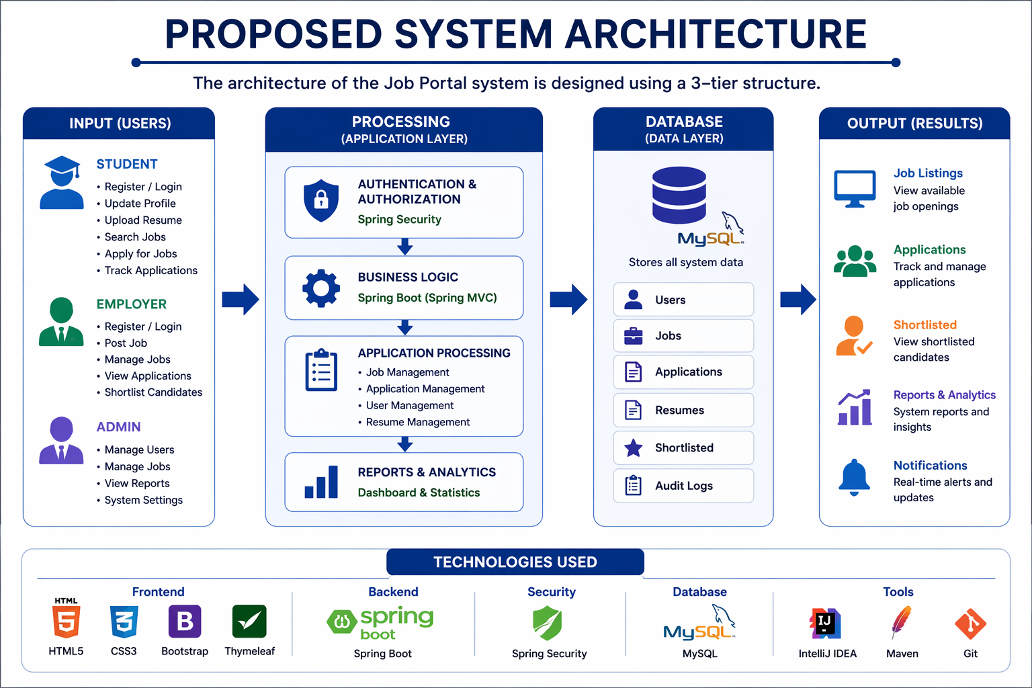
PROPOSED SYSTEM ARCHITECTURE
1
2
3
4
5
6
7
8
9

Slide 7
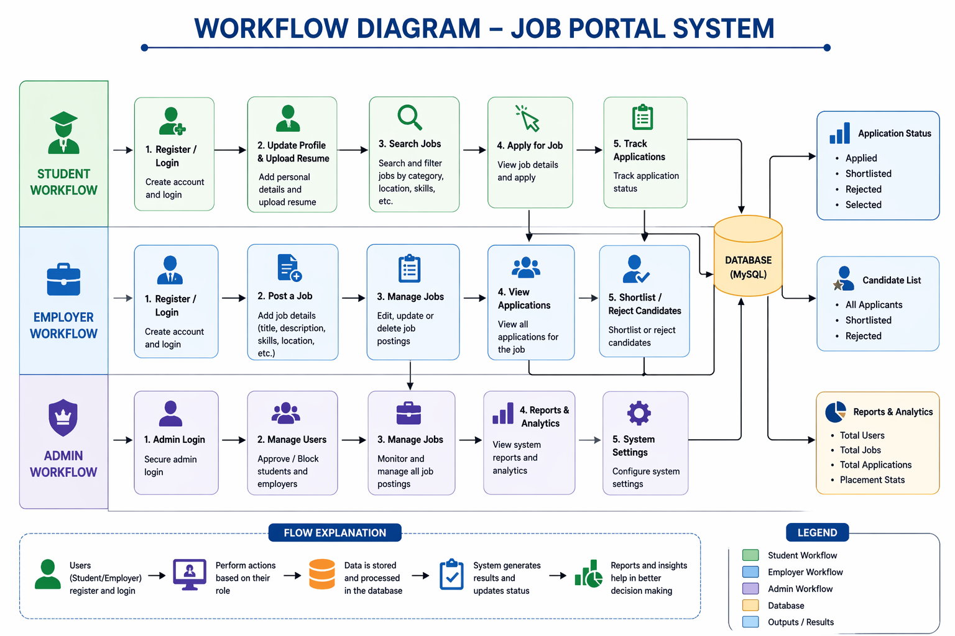
WORKFLOW
1
2
3
4
5
6
7
8
9

Slide 8
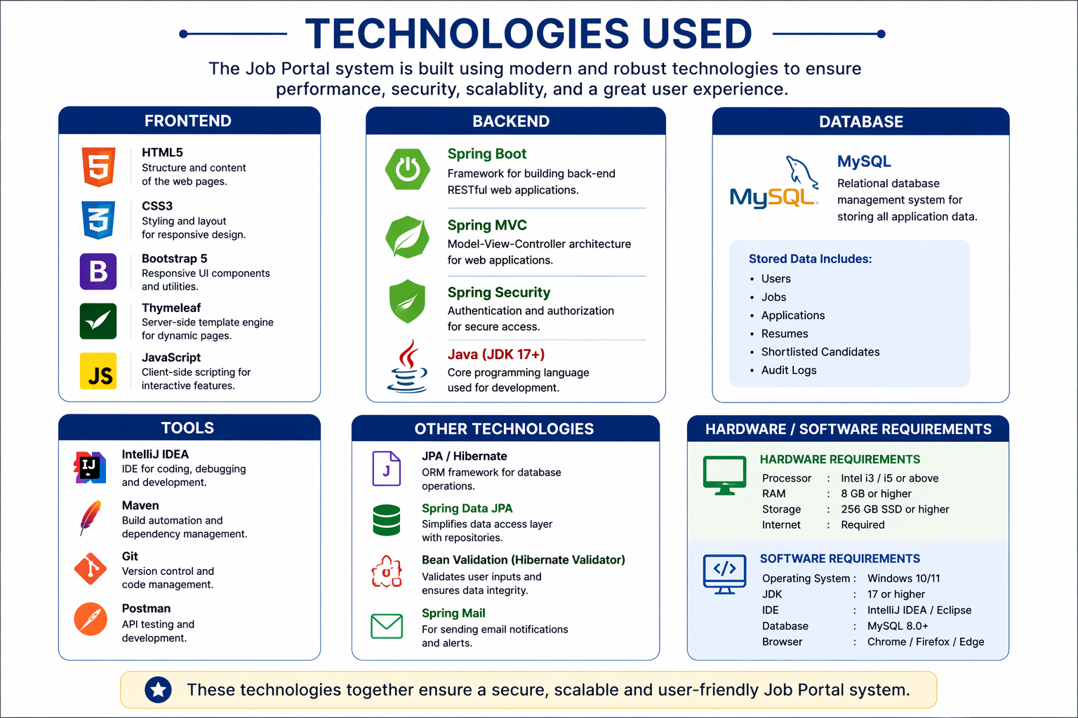
TECHNOLOGIES USED
1
2
3
4
5
6
7
8
9

Slide 9
MODULE DESCRIPTION
Module 1: User Management
Handles user registration, login, logout, and profile management with secure role-based authentication for students, employers, and admin users.
Module 2: Job Management
Allows employers to post new jobs, edit job details, delete expired jobs, and manage available job openings efficiently.
Module 3: Application Management
Enables students to search jobs, apply online, upload resumes, and track the status of submitted applications.
Module 4: Employer Dashboard
Provides employers with tools to view applicants, shortlist candidates, reject unsuitable applications, and monitor hiring activities.
Module 5: Admin Management
Allows admin to manage users, oversee job postings, monitor applications, and control system settings.
Module 6: Reports & Analytics
Generates reports on total users, jobs, applications, shortlisted candidates, and overall recruitment performance.
1
2
3
4
5
6
7
8
9

Slide 10
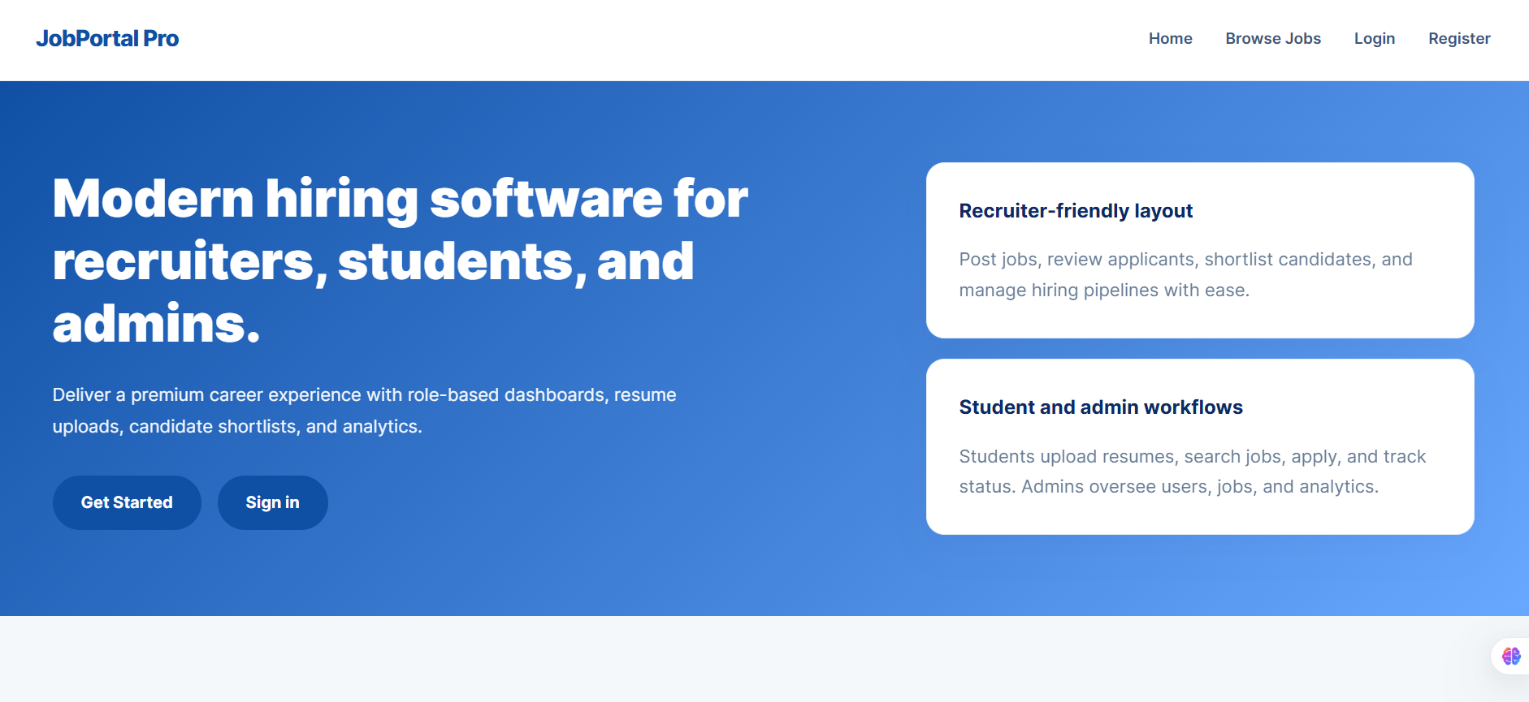
IMPLEMENTATION SCREENSHOTS
1
2
3
4
5
6
7
8
9

Slide 11
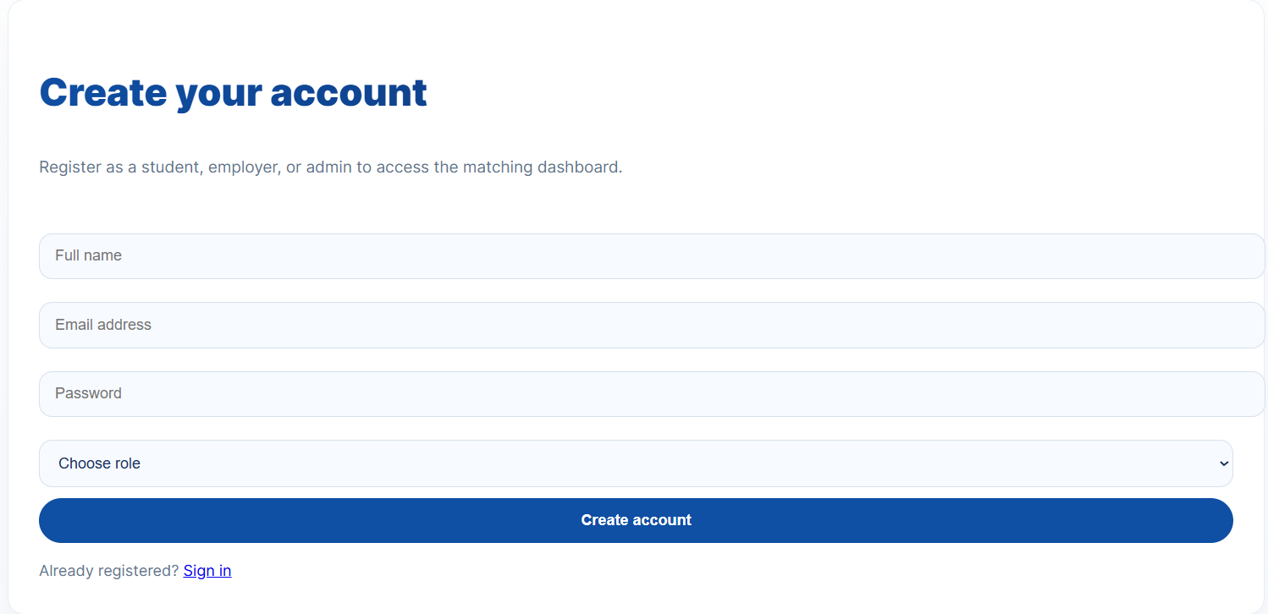
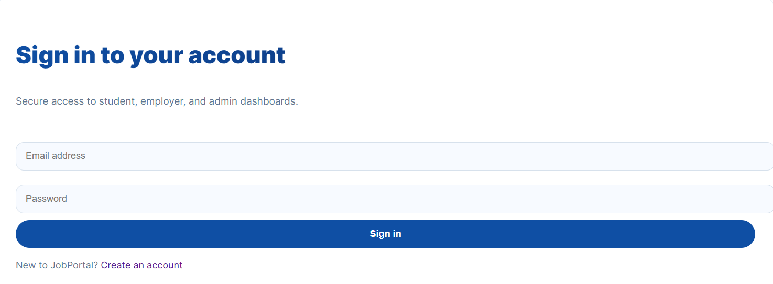
IMPLEMENTATION SCREENSHOTS
Gowtham
1
2
3
4
5
6
7
8(A)
9

Slide 12
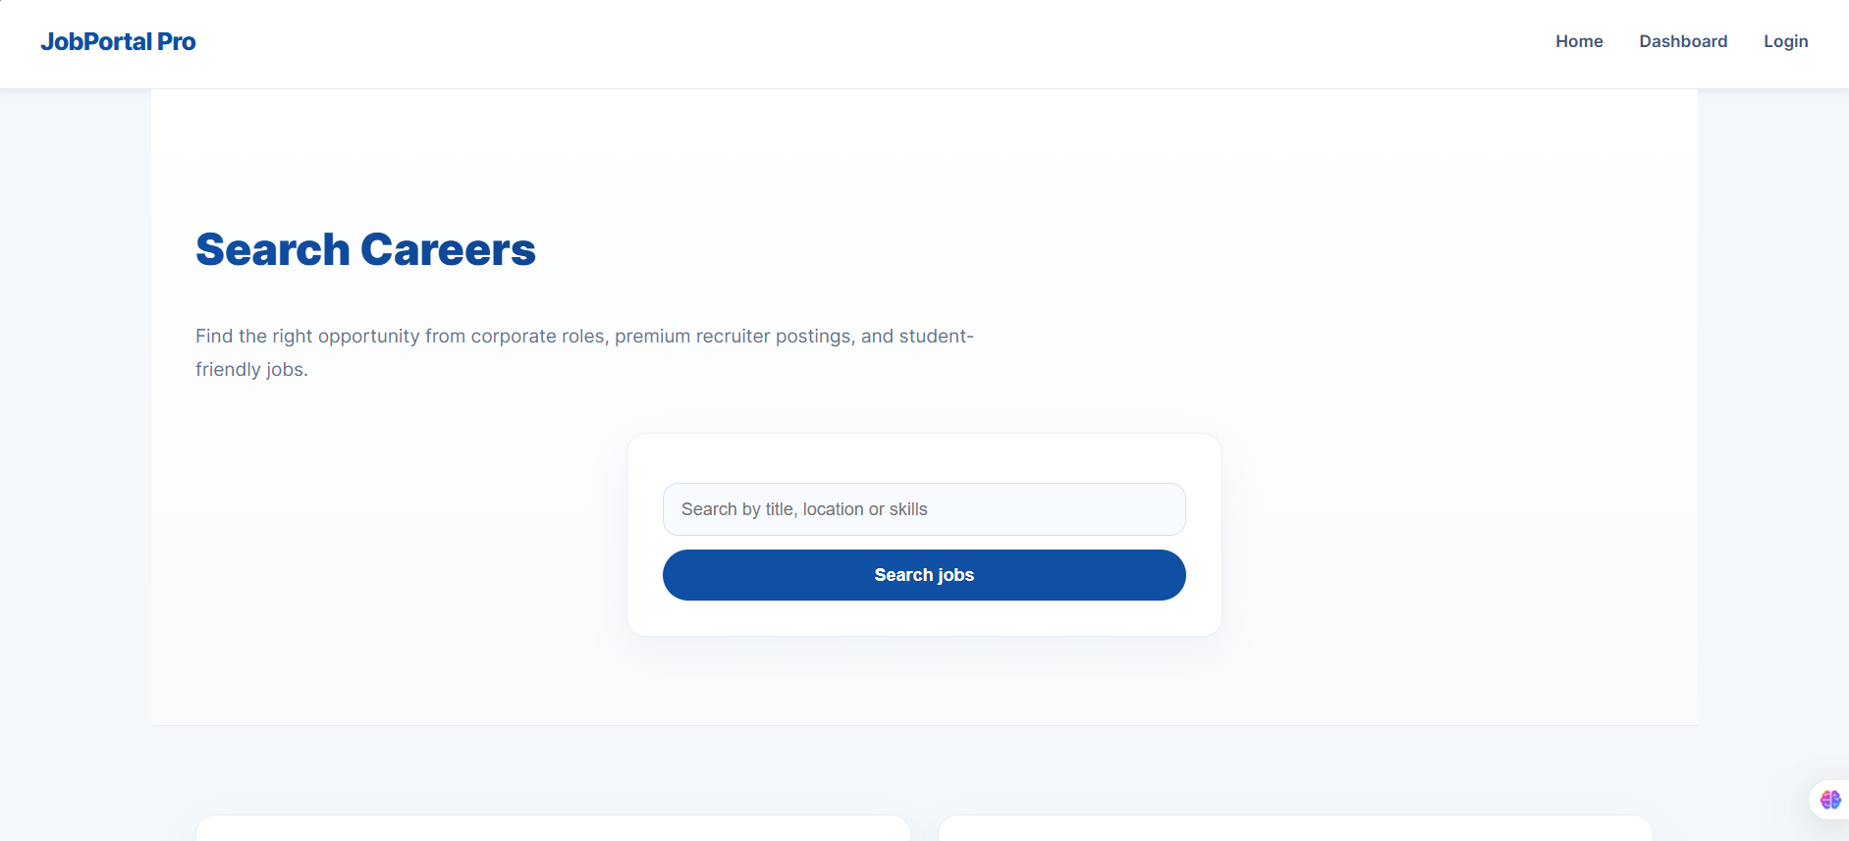
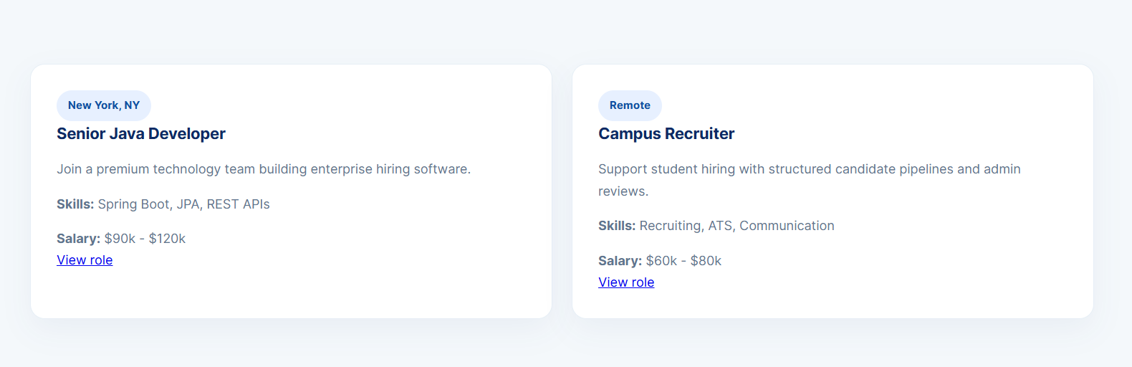
IMPLEMENTATION SCREENSHOTS
1
2
3
4
5
6
7
8(B)
9

Slide 13
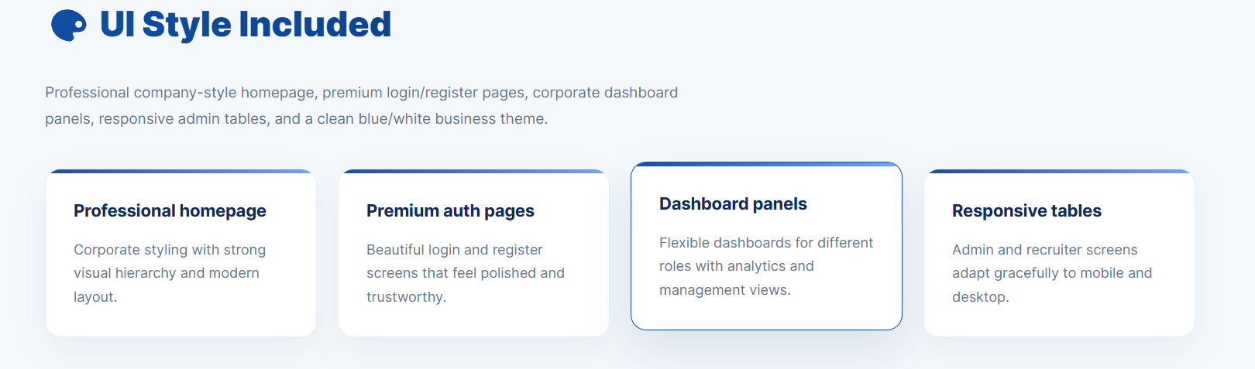
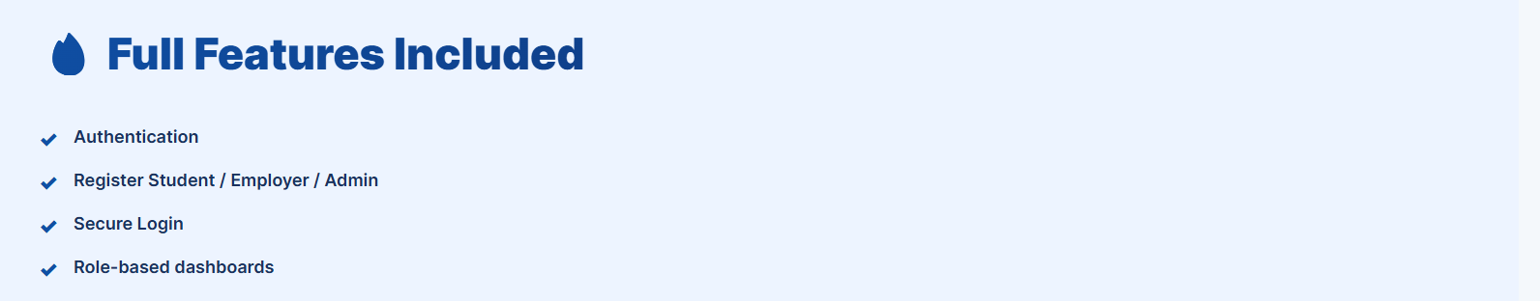
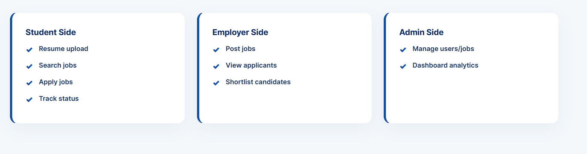
IMPLEMENTATION SCREENSHOTS
Gowtham
1
2
3
4
5
6
7
8(C)
9

Slide 14
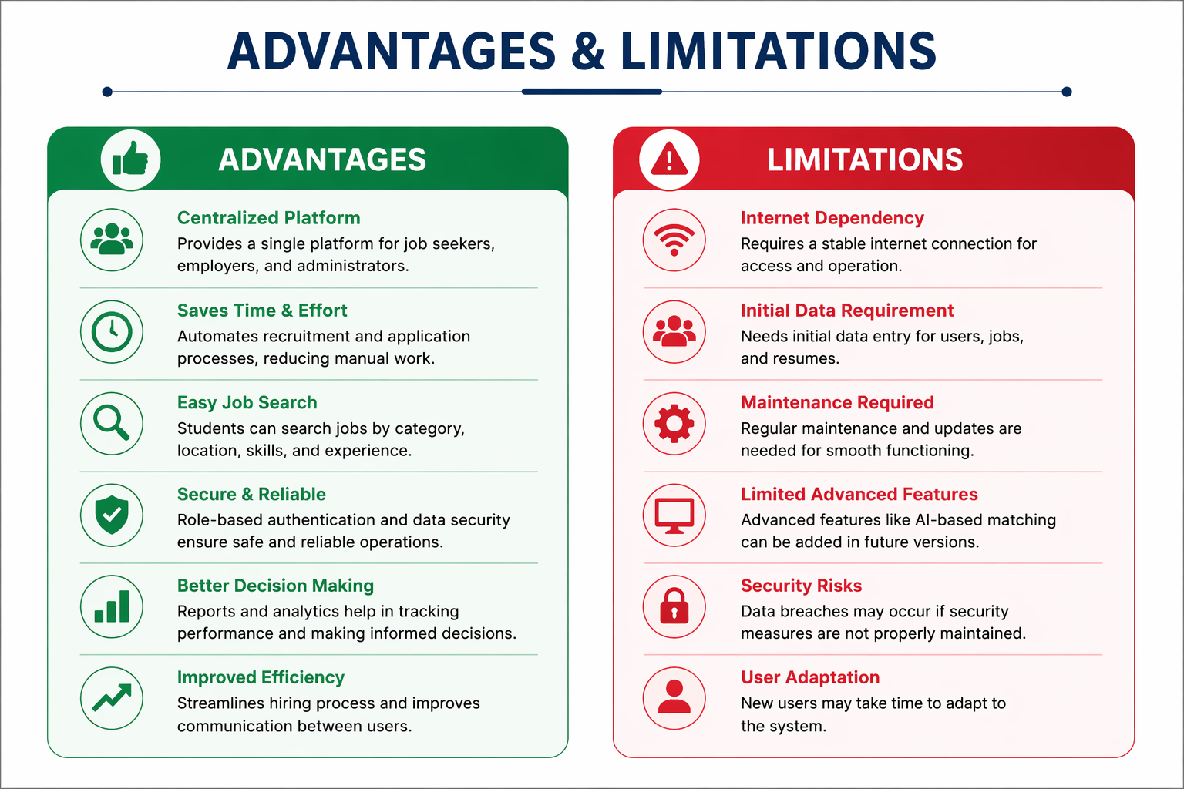
ADVANTAGES & LIMITATIONS
1
2
3
4
5
6
7
8
9

Slide 15
Thank you

